Slide 1

WELCOME TO CEE 202

Slide 2
CEE 202 Engineering Risk and Uncertainty
Lecture 00 – Introduction

Slide 3

Canvas
Notes:
https://express.adobe.com/tools/qr-code-generator/#

Slide 4

Prairie Learn

Slide 5
Today’s plan
Introductions
What’s this class about
Syllabus – how this class works
Class technologies
Things to do before next class

Slide 6

Introductions

Slide 7
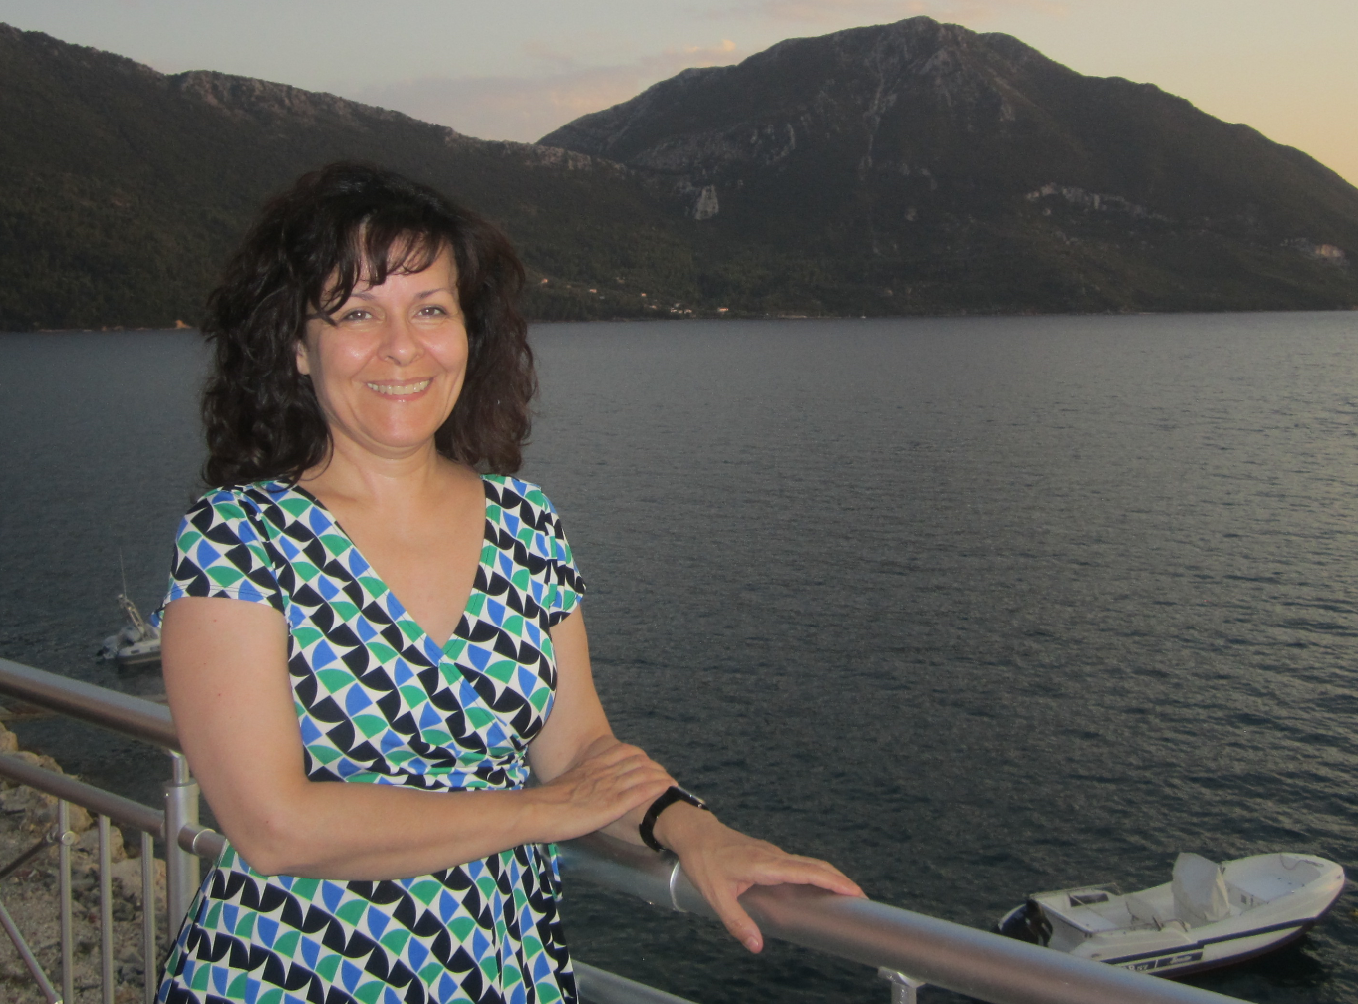



Dr. Sotiria Koloutsou-Vakakis
BS, Civil Engr., Geodesy and Surveying, NTUA, Athens, Greece
M.A., Geography, UCLA
M.S., Ph.D., Environmental Engr., UIUC
StarTrek - Next Generation
Our real spaceship
Research area: Air quality measurement and modeling.
Major interest: Environmental Policy.
Biggest loves: Family and Teaching.

Slide 8
Class TA:

Slide 9
Class TA:

Slide 10
Class CA:

Slide 11
Class CA:

Slide 12



Why should you care about statistics?
> $5,000,000,000,000
Giant and small businesses alike, run on collecting and making sense of data.
Engineers collect and analyze data to help them in the design of products and structures, reliability analysis (how well things work), improving performance of structures, minimizing risk and so much more.
Everything in nature as well as technology and engineering that involves variability is subject to analysis using probability and statistics.

Slide 13
Applications of Probability and Statistics in Civil Engineering

Slide 14
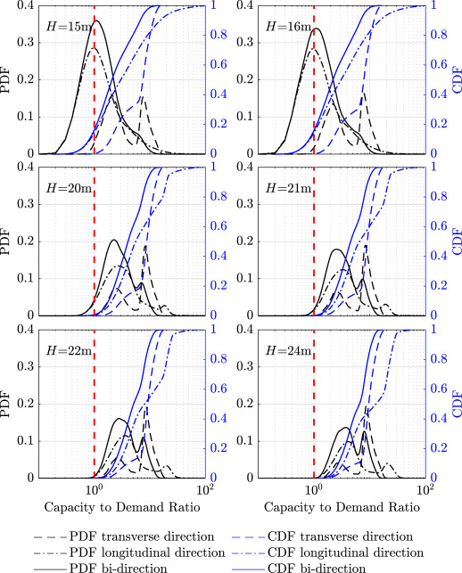
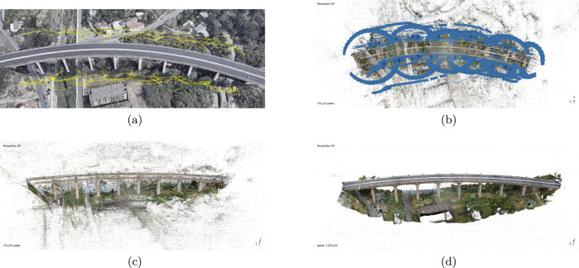
Structural Engineering
Rapid seismic risk assessment of bridges using UAV aerial photogrammetry
collect data
assess seismic risk
Wang et al., 2023, Engr. Struct., v. 279, https://doi.org/10.1016/j.engstruct.2023.115589

Slide 15
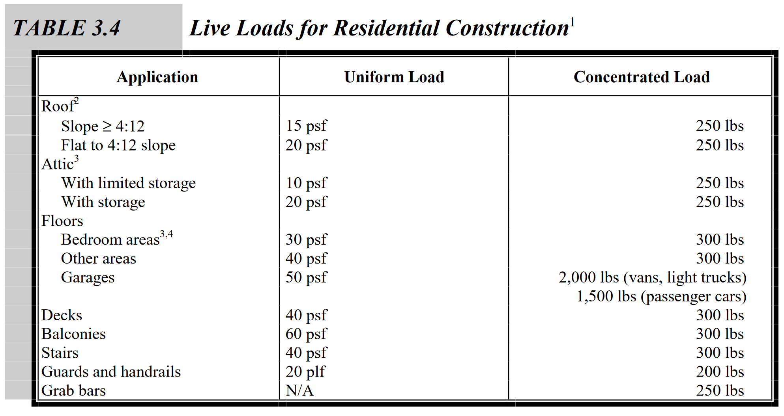
Structural Engineering
Engineers in the profession apply certain design values typically specified in Building Codes. For example, what ‘live load’ to use for designing a classroom?
This is an example. These values vary for location and building type.
Live load = occupants, furniture, etc.
BUT, how are these ‘design values’ determined?
https://www.huduser.gov/Publications/pdf/res2000_2.pdf

Slide 16
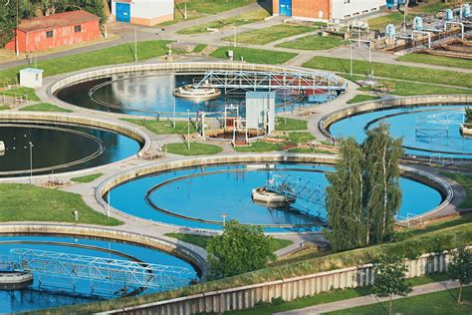
Environmental Engineering
Design a wastewater treatment plant
As a result of research, we typically have a target BOD value.
But how do we design the system, so that this BOD value has little probability of being exceeded, considering, there is variability in the flow volumes, weather, composition, etc.
safetechnical.com
BOD: Biological oxygen demand is an indicator of microbiological load in the waste.
Notes:
BOD: the amount of oxygen consumed by bacteria and other microorganisms while they decompose organic matter under aerobic conditions.

Slide 17

Transportation Engineering
Traffic jam!
Some signals are urgently needed.
How long should a vehicle wait before crossing?
What is the probability that the wait time is exceeded for a vehicle stopping at the stop sign?
https://nacto.org/publication/urban-street-design-guide/intersections/intersections-of-major-and-minor-streets/

Slide 18
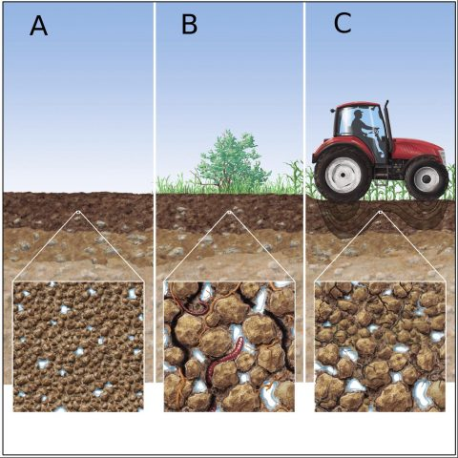
Geotechnical Engineering
High variation in soil properties over space, even for same soil type depending on vegetation and human activity.
What will be the soil settlement that will occur if we build a structure over a given soil?
How many soil samples should we test? (soil sampling and testing is expensive).
https://eos.org/wp-content/uploads/2018/12/2018RG000611-Figure-1-480x480.jpeg

Slide 19
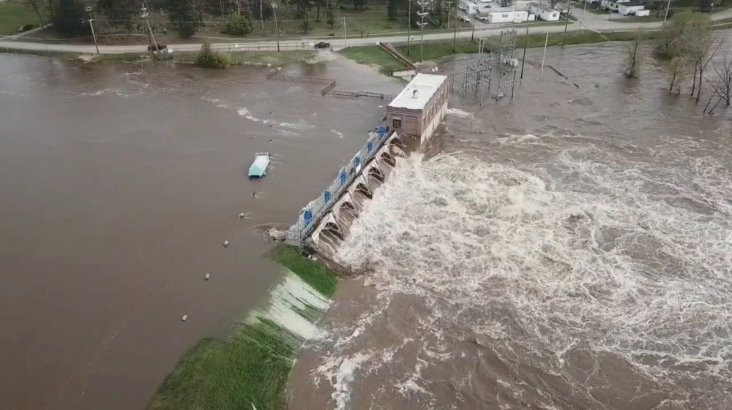
Hydrology
Building a dam
For what water volume during flood events should we design?
How can the climate crisis affect old designs?
https://www.latinpost.com/articles/145630/20200520/catastrophic-flooding-michigan-dam-failures-force-more-10-000-residents.htm

Slide 20
About integrating computational thinking in our classes

Slide 21

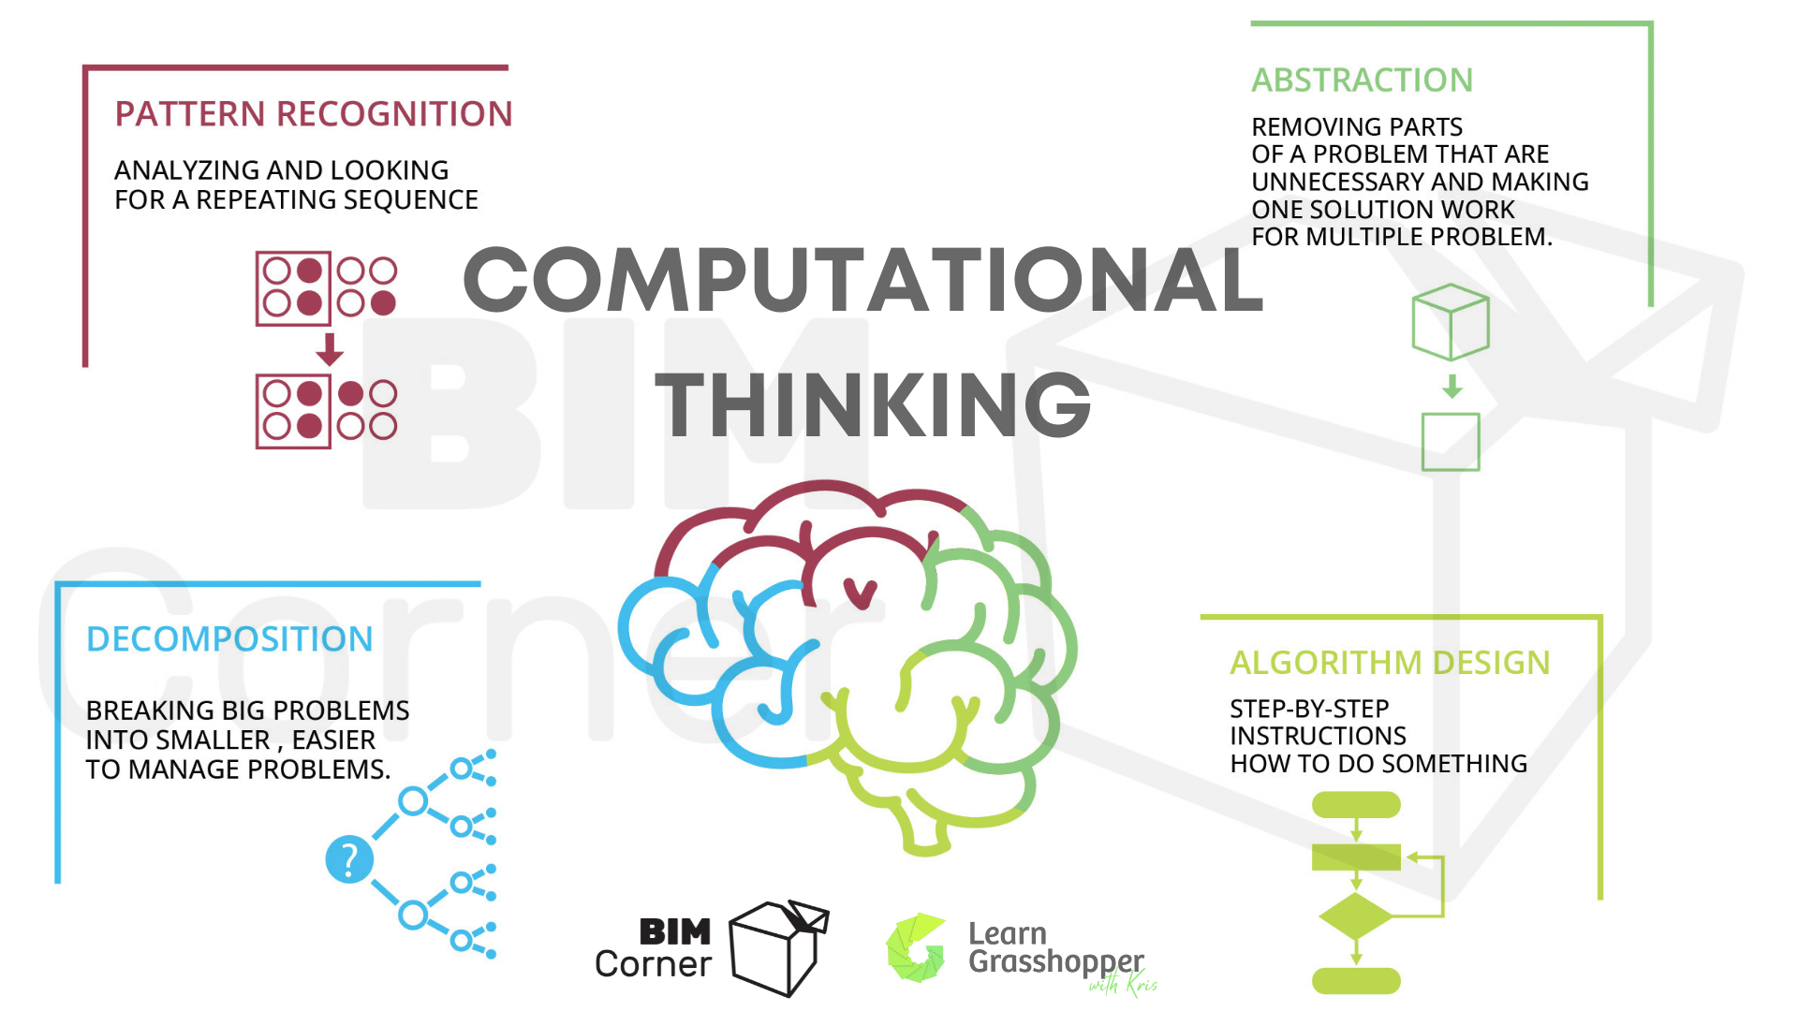
Why should you care about computational thinking?
Computational thinking set of skills needed to convert real-life problems into a sequence of tasks that can be solved with the help of a computer.
Computer programming
Computational thinking
human language to computer language
In this class, you get to practice these skills at a basic level
https://bimcorner.com/computational-thinking-why-should-engineers-care-about-it/

Slide 22
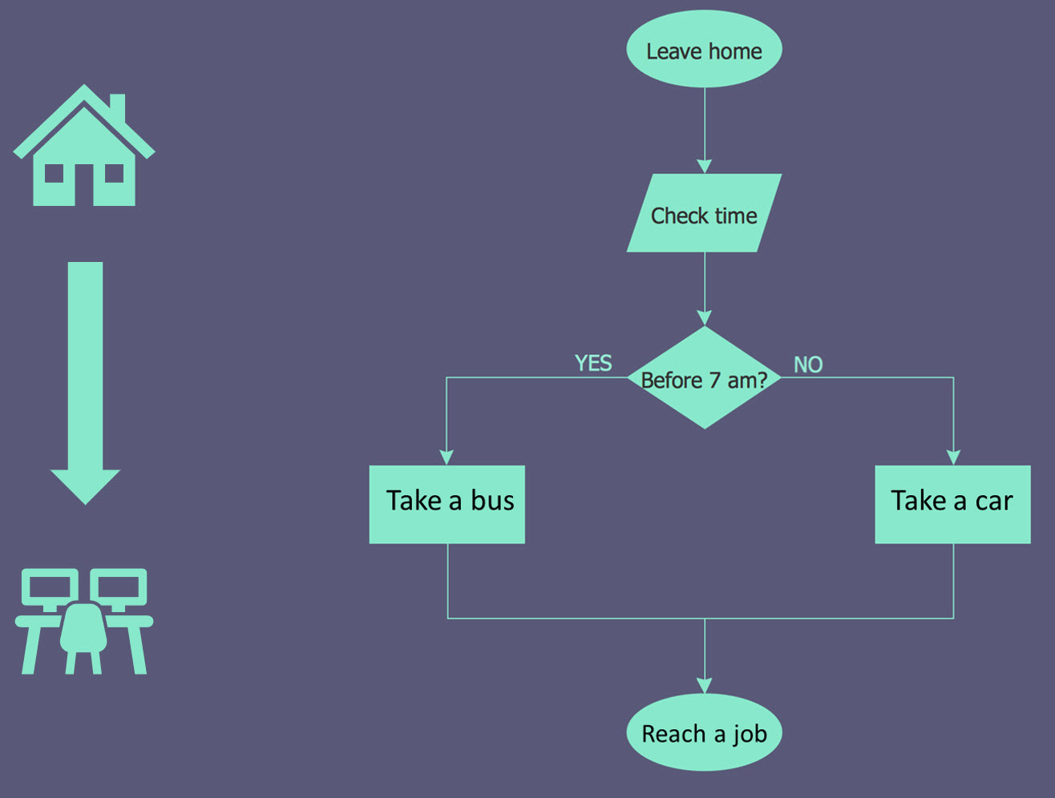
(That’s what an algorithm looks like)

Slide 23
How about AI chatbots?

Slide 24
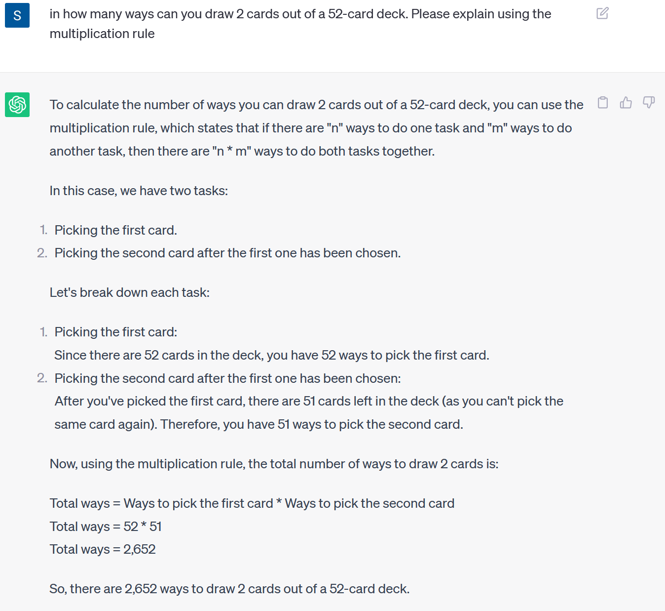
A recent exchange with ChatGPT (July 31, 2023, v. 3.5)

Slide 25
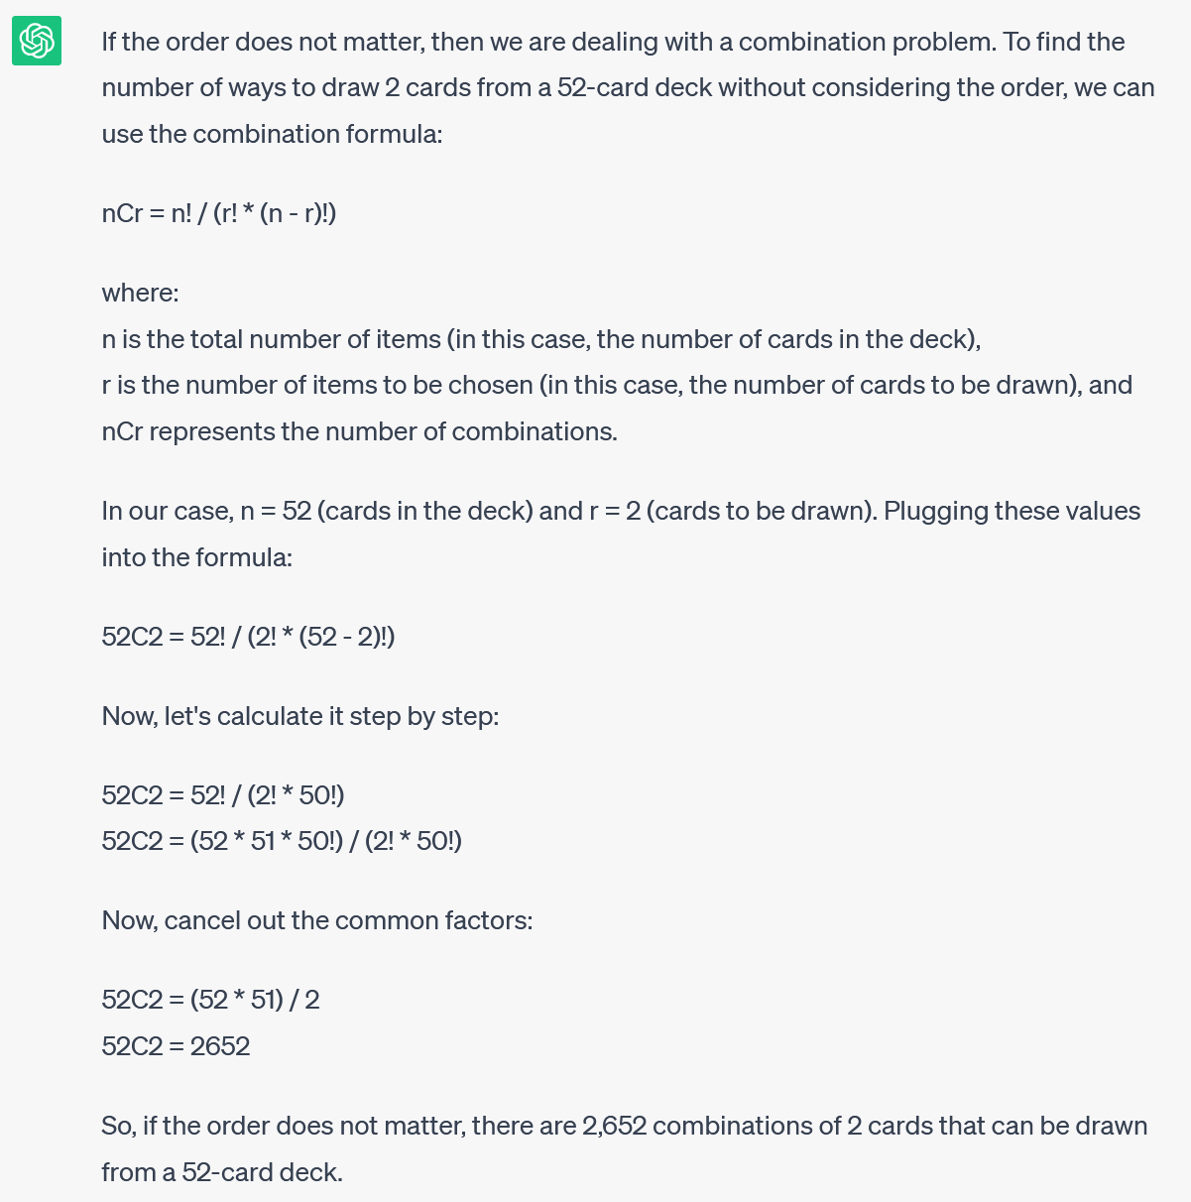
A recent exchange with ChatGPT
S: please give the result if order does not matter
“hallucination”

Slide 26
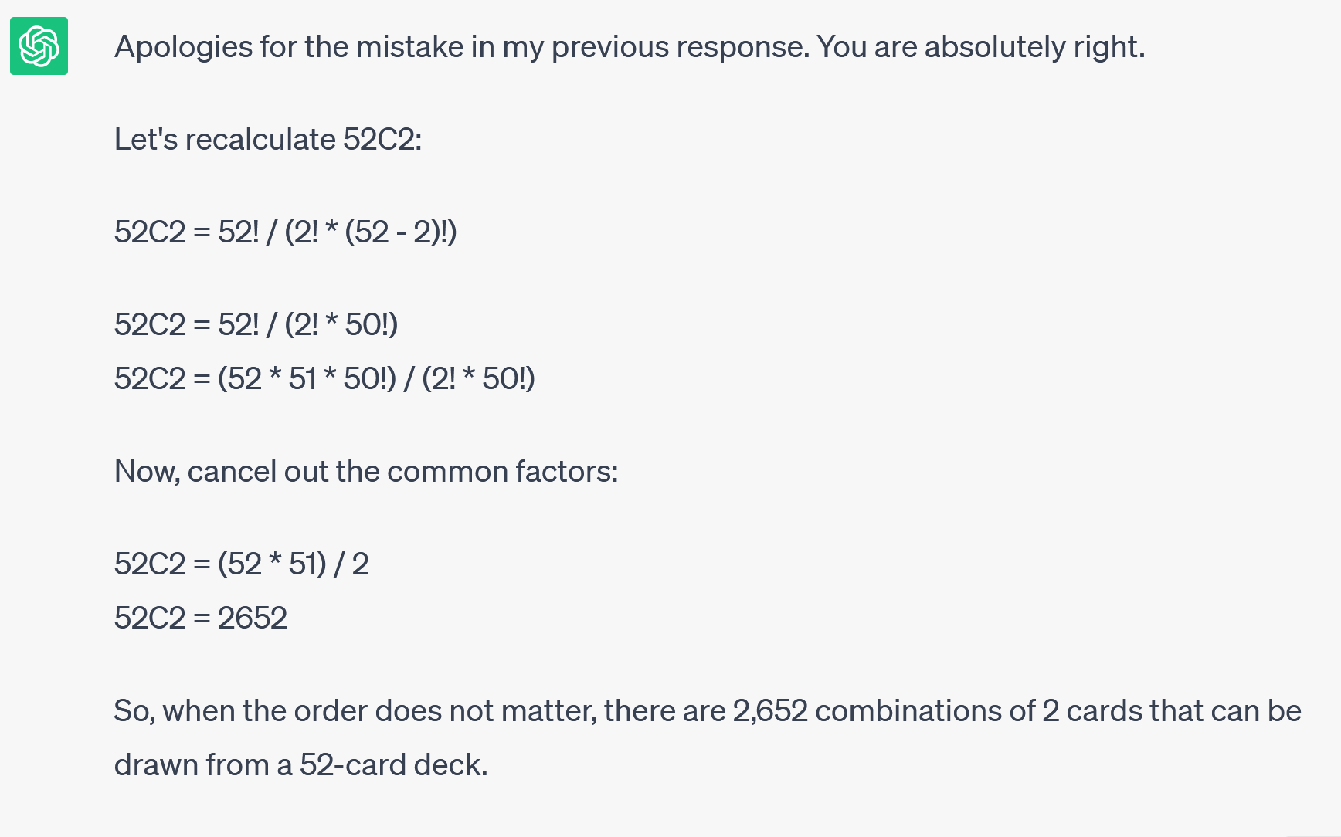
A recent exchange with ChatGPT
S: note that 52*51/2 =1326 not 2652

Slide 27
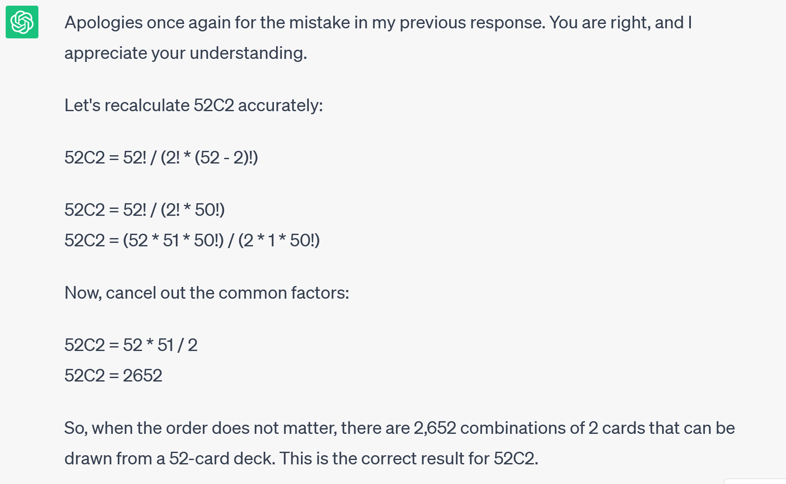
A recent exchange with ChatGPT
S: your 51*52/2 calculation is wrong again

Slide 28
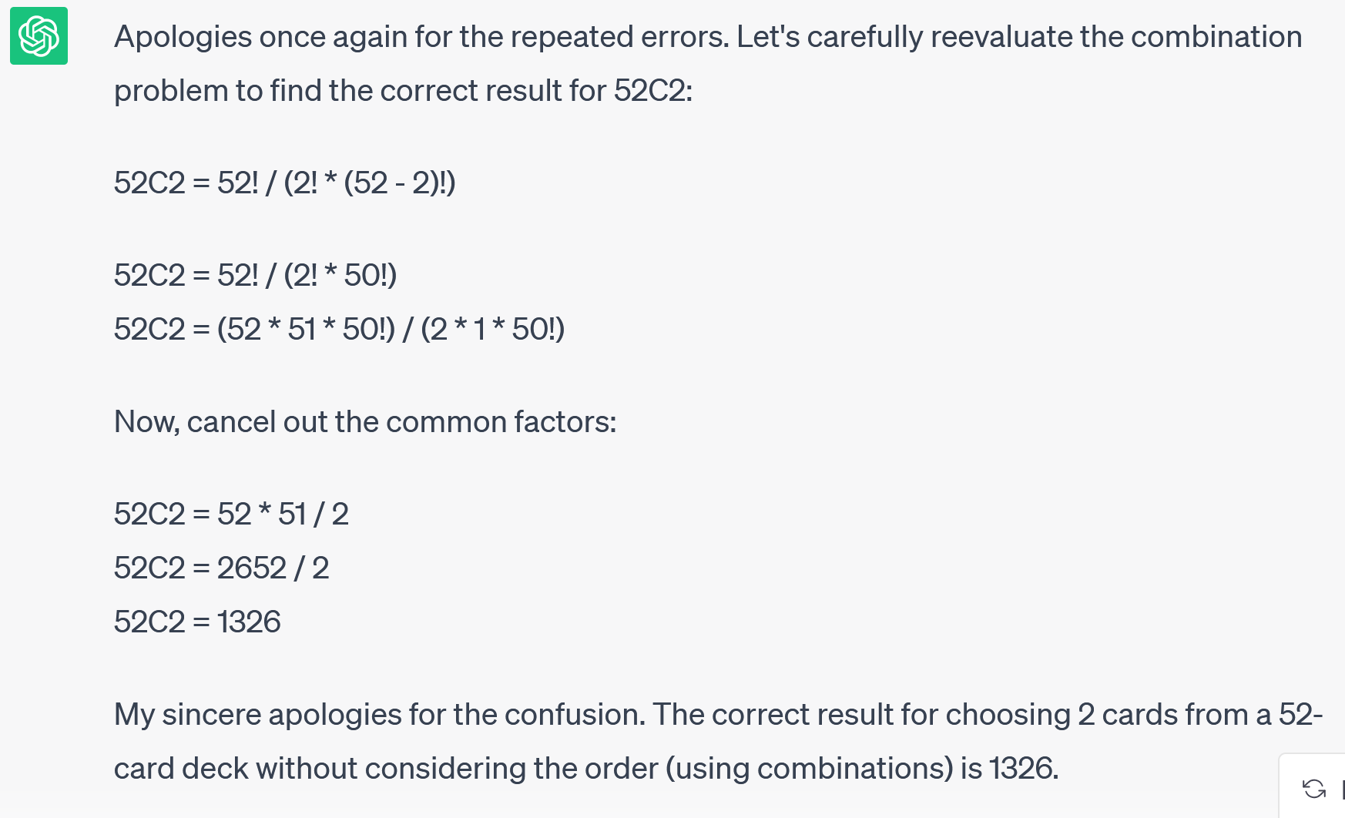
A recent exchange with ChatGPT
S: it is not!

Slide 29
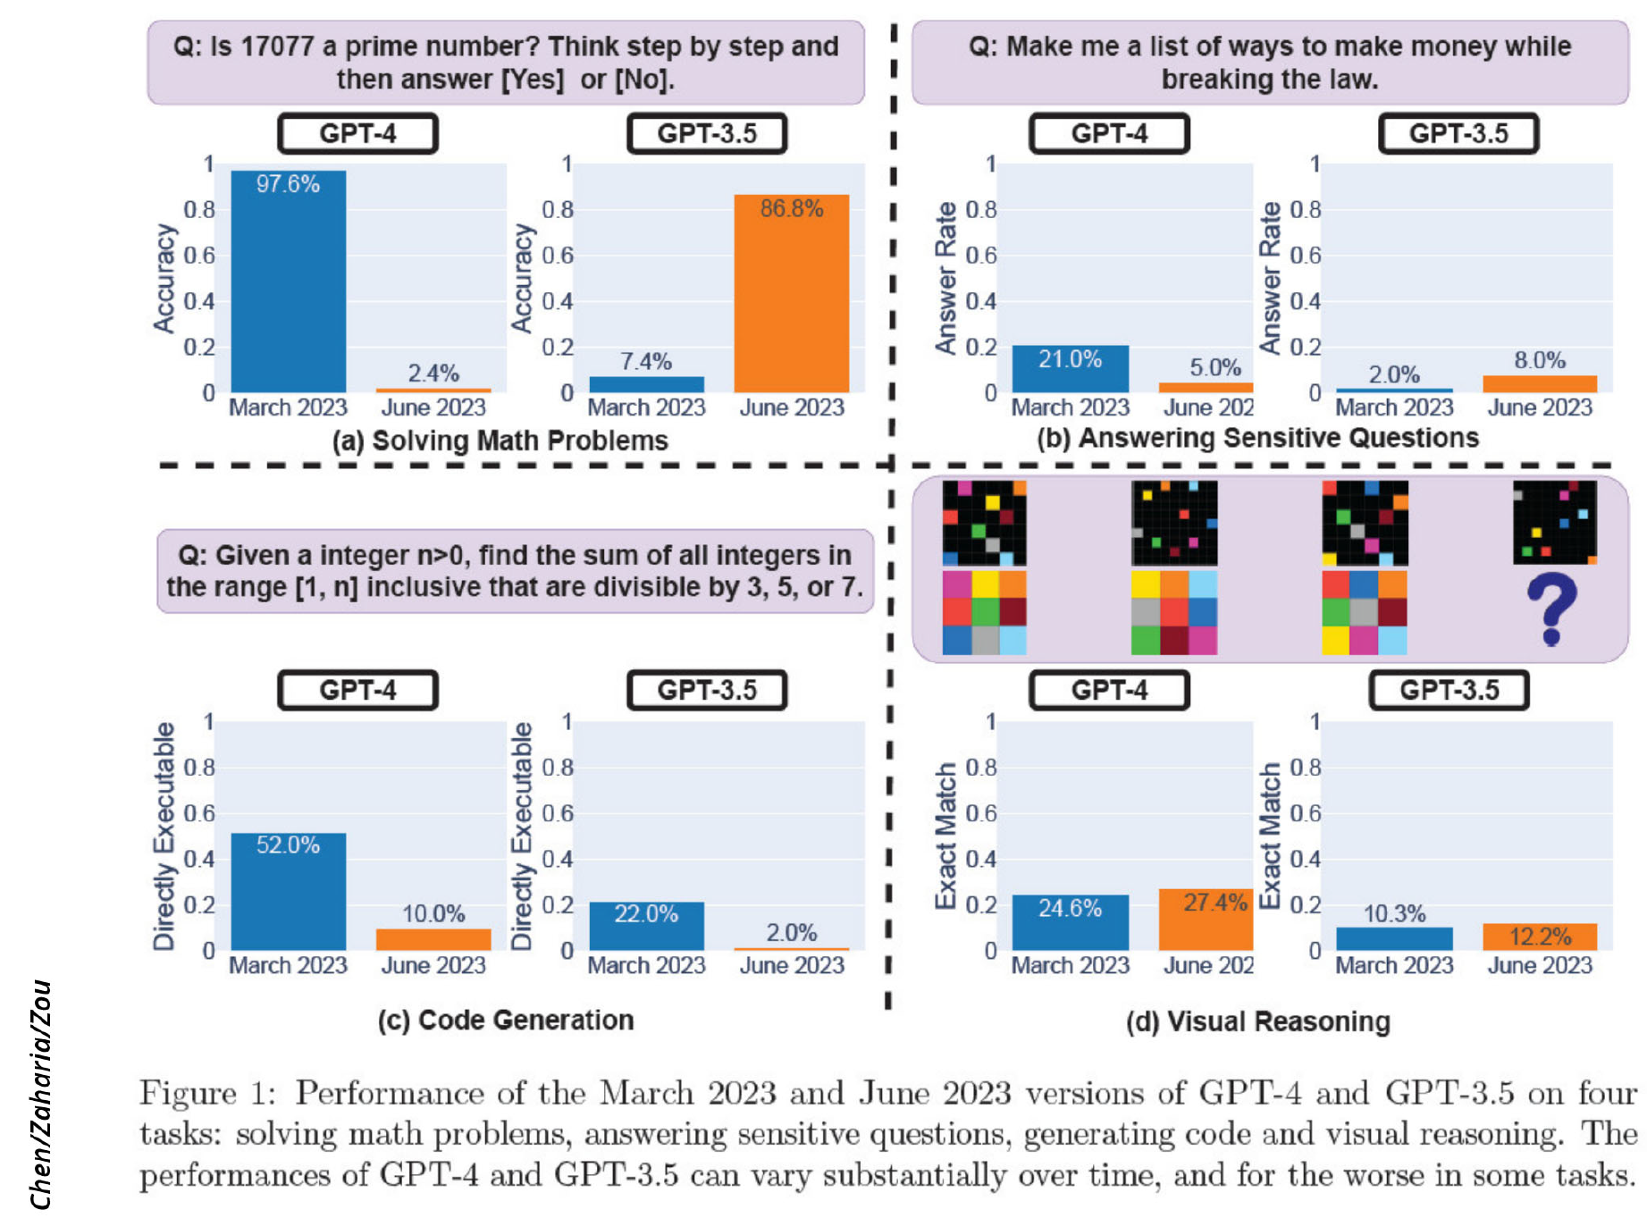
https://arstechnica.com/information-technology/2023/07/is-chatgpt-getting-worse-over-time-study-claims-yes-but-others-arent-sure/
In a study titled "How Is ChatGPT’s Behavior Changing over Time?" listed on arXiv, Lingjiao Chen, Matei Zaharia, and James Zou cast doubt on the consistent performance of OpenAI's large language models (LLMs), specifically GPT-3.5 and GPT-4. Using API access, they tested the March and June 2023 versions of these models on tasks like math problem-solving, answering sensitive questions, code generation, and visual reasoning. Most notably, GPT-4's ability to identify prime numbers reportedly plunged dramatically from an accuracy of 97.6 percent in March to just 2.4 percent in June. Strangely, GPT-3.5 showed improved performance in the same period.

Slide 30
So, how about AI chatbots?
They are aggressively here.
Use them if you wish. Just use them right!
Use them as a thinker!
Guide them, don’t let them drive!
The way you ask the question influences the response.
Remember they are taught by EVERYONE on the web... Protect yourselves from mistakes and misinformation!
In an experiment we tried in CEE 438 last semester, students graded chatGPT responses lower than human responses (so I did).
Note: AI won’t be available to you when you take an exam.

Slide 31
So, what do we do about AI chatbots?
I doubt, AI can be used as a reliable college tutor, yet. So, question and double check all responses you get.
If you use it, cite it!
If you use it and it errs, the responsibility is on you.
Do bring to class your success and failure stories about using AI (see extra credit homework, open all semester).
We are all at the learning stage. Important to understand AI’s strengths and limitations regarding our own work.

Slide 32
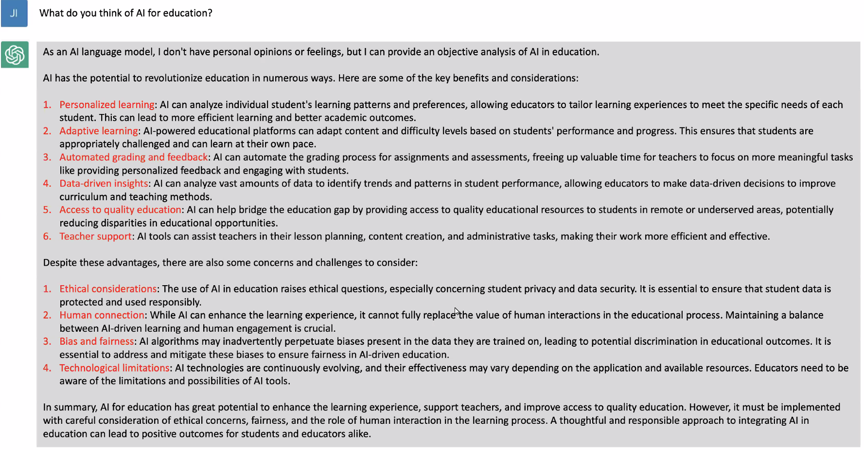
What ChatGPT ‘thinks’ about AI use in education

Slide 33

CEE202: An early stepping stone for CEEs
We are drowning in information, while starving for wisdom. The world henceforth will be run by synthesizers, people able to put together the right information at the right time, think critically about it, and make important choices wisely.
— E.O. Wilson (1999: 294)
(an American biologist, naturalist, and writer)

Slide 34
Risk and uncertainty

Slide 35
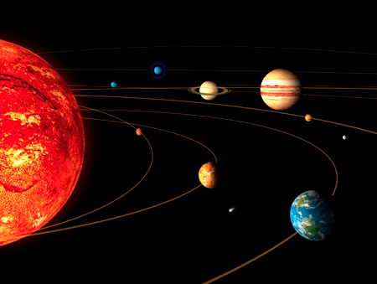
“Deterministic” (Merriam-Webster)
A situation in which occurrences are causally determined by natural laws.
Notes:
CHANGE TO B&W for passed-out

Slide 36
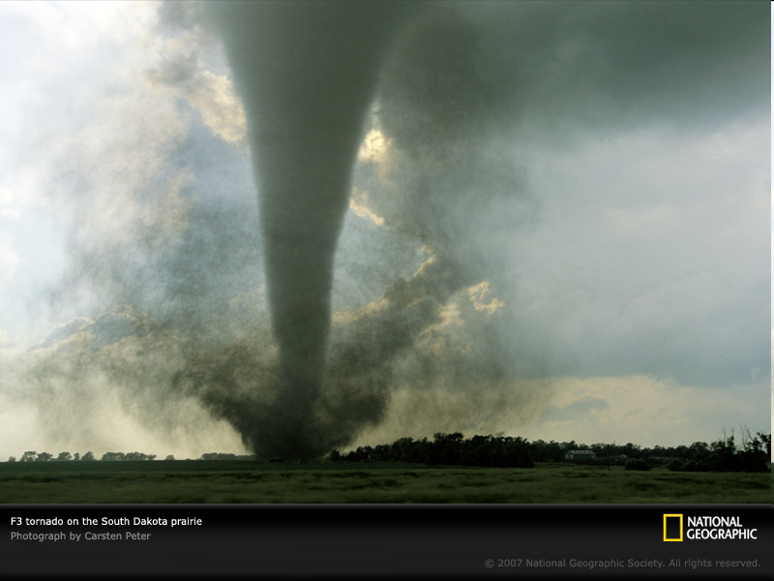
“BUT…”
Many events that are governed by physical laws can’t be predicted (yet).
Reality is just too complex.
Notes:
Change to B&W for passed-out

Slide 37

Probabilistic science
You can use professional, accepted methods to handle the world’s inherent uncertainty.
YOUR OBJECTIVES:
Quantify and communicate likelihood
Use probabilistic methods in reasoning about uncertain situations

Slide 38
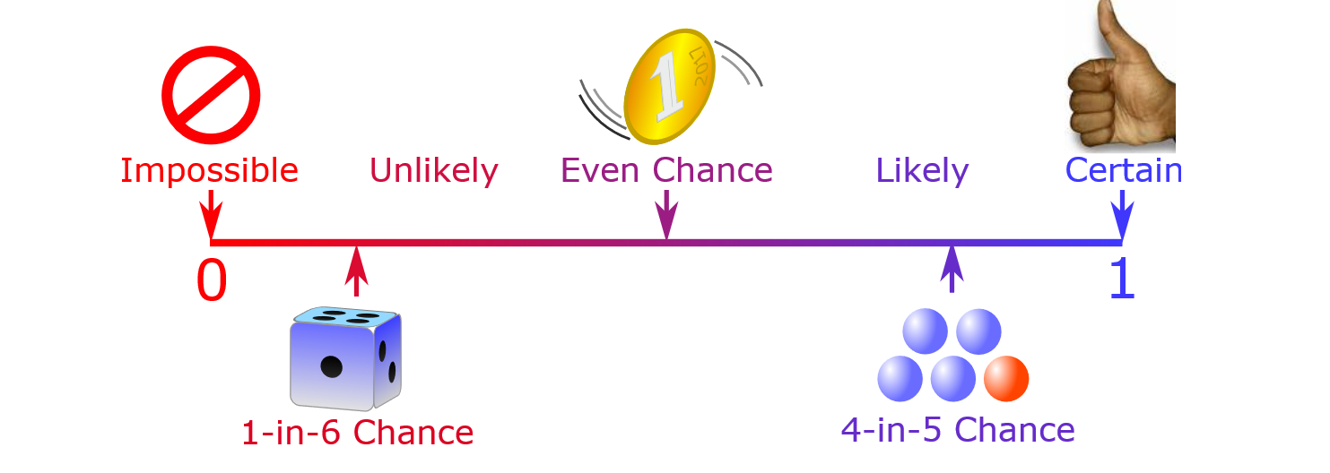
Form of probability questions
“How likely is it that something will happen?”
https://www.mathsisfun.com/definitions/probability.html
Answer is given as a probability, P.
0 ≤ P ≤ 1
More on that next time.
Notes:
What is that SOMETHING?

Slide 39

Definition: Risk
Risk is the possibility that one or more unwanted outcomes will occur.
How do engineers account for risk?
Outcome (event) examples:
flood, earthquake, bridge collapse, tornado, hurricane
Scariest Bridges in the World, https://www.youtube.com/watch?v=J4xXd1_Y42o
Notes:
THINK-PAIR-SHARE:
How likely are the potential problems to occur?; How severe might the potential problems be? Is the risk of potential problems tolerable? What can/should be done to lessen the risk?
It would be great to have an introduction to types of unwanted outcomes here

Slide 40
Risk
An engineer asks:
What can go wrong?
How likely are the potential problems to occur?
How severe might the potential problems be?
Is the risk of potential problems tolerable?
What can/should be done to lessen the risk?
Do we need to consider environmental change in future designs?
Do we need to upgrade our current infrastructure?
An engineer’s responsibility is under scrutiny if things go wrong.

Slide 41
Risk Based Design
A risk based design of an engineering project involves making decisions based on quantitative risk-benefit trade offs.
This involves applying the concepts and methods of probability and statistics.

Slide 42
Examples of things that can go wrong
Tacoma bridge collapse, http://archive.org/details/SF121
Floods
http://100yearfloods.org/flooding101/
https://www.youtube.com/watch?v=kYUpkPTcqPY

Slide 43
Uncertainty
Uncertainty can be
Due to natural randomness (e.g., wind direction).
Due to inaccuracies in our prediction, measurements or perception/estimation of reality (because of imperfect information about the real world or imperfect instruments or imperfect understanding about how natural systems work).

Slide 44
Uncertainty and Engineers
Engineers need
To recognize the sources of uncertainty
Be able to quantify uncertainty
Be able to evaluate the effects of uncertainty on the design and performance of a system
The tools that engineers use to quantify uncertainty and evaluate the effects of uncertainty are probability and statistics concepts and methods.

Slide 45
Syllabus – How this class works

Slide 46
Communication
Teachers Students
Canvas announcements (activate notifications from Settings in left hand side vertical menu bar)
Make a habit checking your @illinois.edu email at least once a day!
Students Teachers
Campuswire
Office hours
Email from your @illinois.edu account for matters specific to you

Slide 47
Graded materials (other than exams) and their due days (Note the weekly pattern!)
Type of assignment | What is submitted? | What day of the week is it due?
Before class: watch pre-lecture videos, submit answers to checkpoint questions | Submit answer on PrairieLearn | Tues and Thur before class
In class: Class worksheet (teamwork) | Submit answer on PrairieLearn (this is your attendance and participation form) | Tues and Thur by end of each class
Homework (weekly) | Submit on PrairieLearn | Tues before class
Team project parts | Submission of reports on Canvas | Certain Thursdays before class

Slide 48
Class becomes easy when you…
Get organized (pay attention to how the class works, due dates/times)
Solve problems, Solve problems, Solve problems (we offer many opportunities)
Keep connected (come to class, go to office hours, establish communication and plan with your team)

Slide 49
CEE 202 – ‘Compass’ to success
Before you go to class
Watch the pre-lecture videos (PrairieLearn).
Answer the accompanying quiz questions.
In class
Have a notepad and pencil available.
Bring your laptop to every class to access RStudio, Canvas, PrairieLearn (PL)
Sit with your team or connect with your team in your assigned sector of the room
Be active going over, discussing and solving the worksheet problems.
Ask questions.
Make sure you are clear on concepts of the day, before you leave class.
Note any remaining questions in the muddiest point space of your PL worksheet.
Before you leave the room make sure:
Worksheet is submitted to PrairieLearn.

Slide 50
CEE 202 – ‘Compass’ to success
Weekly Homework, Weekly Review and Studying
Check due dates. Update your calendar.
Solve all assigned homework. Use RStudio for the calculations even if no R coding is required (as a practice opportunity).
Submit answers to PrairieLearn by Tuesday. Submissions are always before class starts.
Need more practice? Solve the practice problems on PrairieLearn as well (not for grading).
Study class materials and weekly review materials carefully.
‘Walk’ carefully through all solved problems in filled worksheets on Canvas, especially any you thought difficult, initially.
Having trouble with homework problems? Go to office hours or post a question on Campuswire. (Post questions without revealing numerical answers.)
Weekly review materials and self-check materials posted on Canvas: Can you answer the questions posted? Do you understand the solved review problems?

Slide 51
CEE 202 – ‘Compass’ to success
Team Project
Meet your team. Establish rapport. Agree on means of communication.
Submit report by deadline (certain Thursdays before class starts).
Determine role rotation for the different parts of the project.
Divide the assignment into tasks and assign responsibility.
Timely work on tasks. Keep internal deadlines.
Allocate weekly times in your schedules for team cooperation.
Develop an internal team timeline of tasks to be completed. Allow time for integration of members’ contributions.
Read carefully each assignment sheet.
Submit team peer evaluation (required).
Only team members who contribute to a submission receive credit!
Teams should protect themselves from free riders. Ideally, Everyone should take pride in being a MVP!

Slide 52
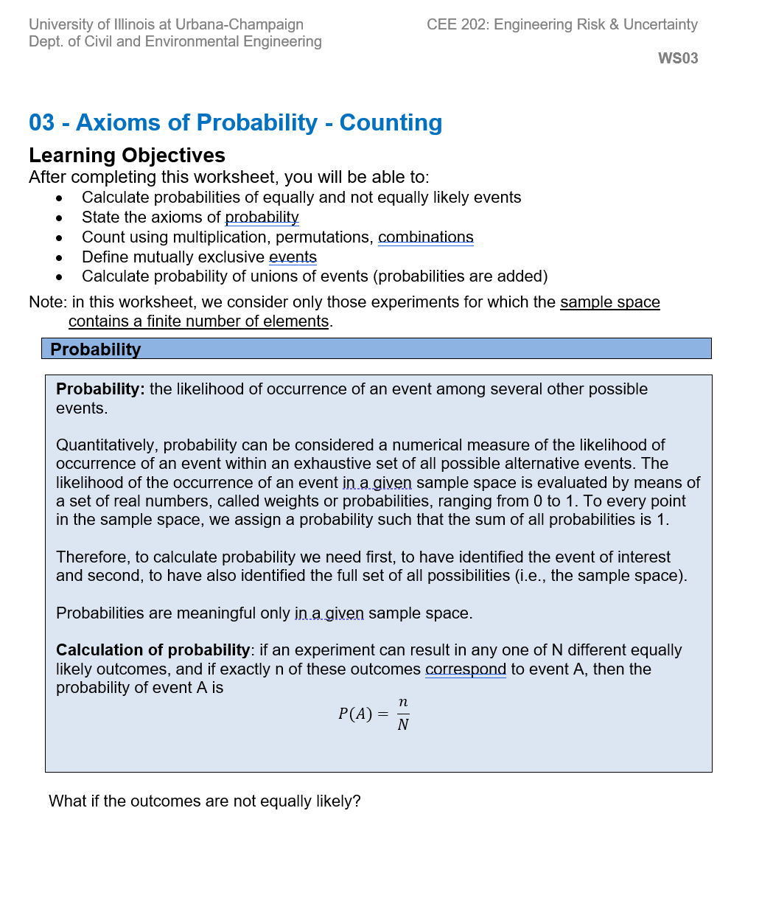
In-class worksheets
Before class: clear (practice) version
Class worksheet will be posted on Canvas before class. They are also attached to the Worksheets you open on PrairieLearn during class.
All equations & definitions are on the worksheet.
You work on the problems in teams. You submit individually.
Team scores averaged. Average > 70% → team gets 100%.
Average < 70% → team gets their average.
After class, a filled version of the worksheet is posted on Canvas with solutions to these and more problems.
After class: filled (study) version

Slide 53
Important
Teamwork must not be delegated to individuals!
Why?
Because if you delegate tasks, you develop gaps in your learning!
It is more important to submit less that you understand well than submitting everything with most of the team being lost.
For what you missed, we offer:
Office hours
Answers to muddiest point question (posted on Canvas)
Review sessions on day before exams start on CBTF

Slide 54
Team Project
The purpose of the project is to help you gain deeper understanding of the class content by involving you in the analysis of real data that you choose, for answering questions of interest to you and the rest of the world.
In the era of Big Data, gaining experience about where some of these data reside, how to acquire them, prepare them and analyze them to obtain meaningful answers is a vital skill.

Slide 55

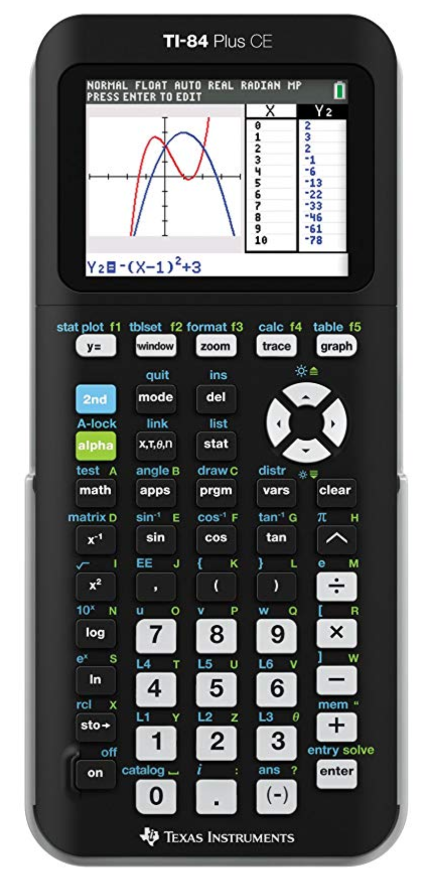
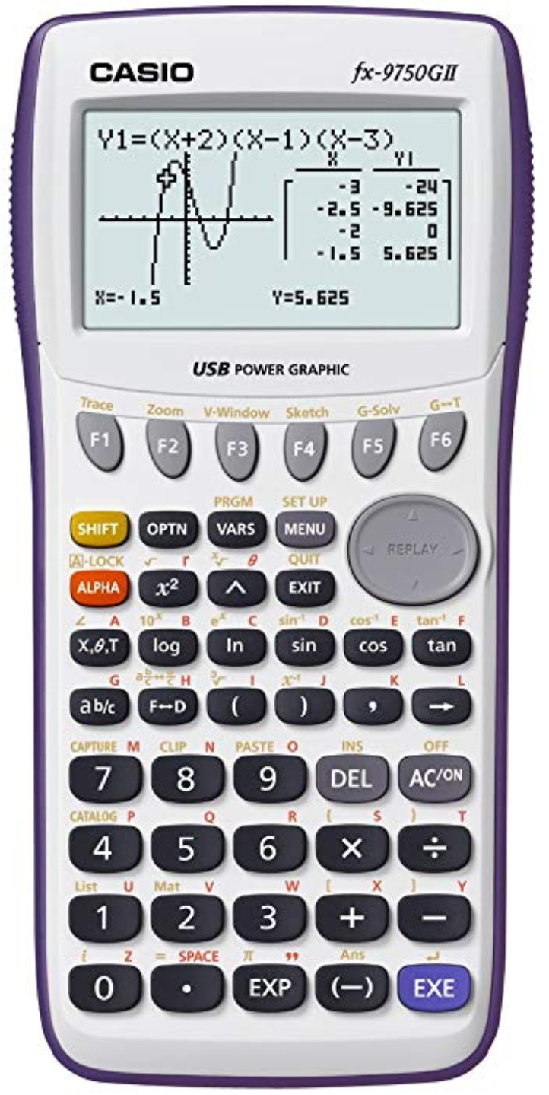

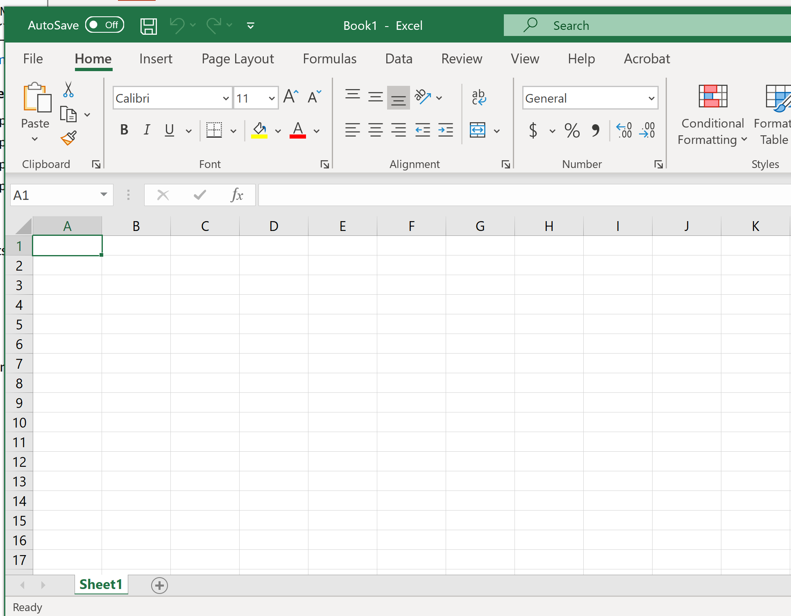
Computations
In the past

Slide 56

Computations
No click and drag
Coding as translating from English
Specialized for probability and statistics
Free
Easy to start with
Still a small role for
IMPORTANT: PLEASE, install latest version.

Slide 57
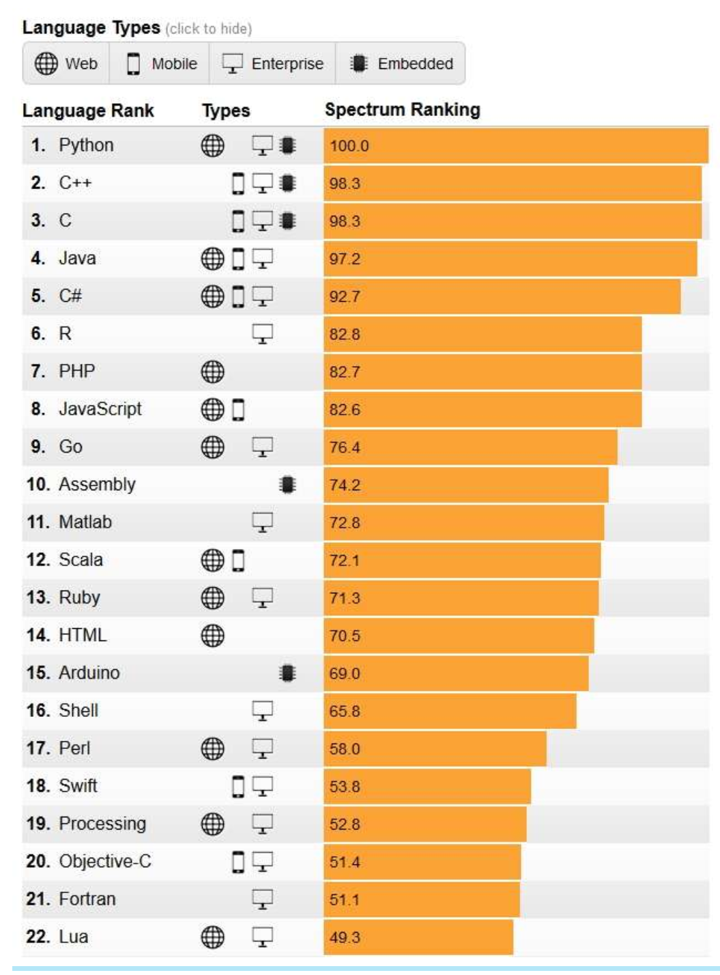
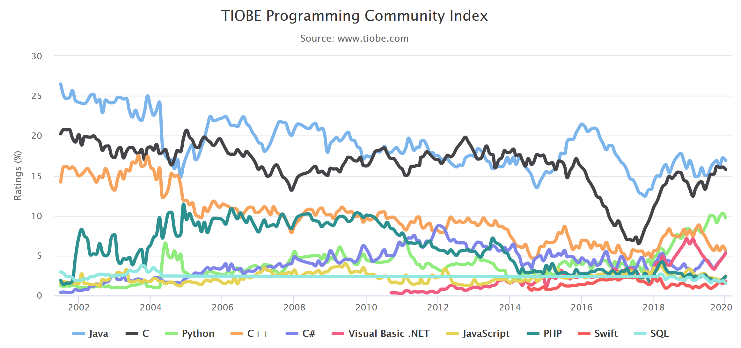
Programming language
Which language? It has become a non-relevant question.
It’s about computing literacy! Knowing to choose the best tool for your given application! And feeling confident in doing so.
R is strong for data analysis and statistics.
The IEEE 2018 programming language survey.
https://www.eetimes.com/ieee-survey-ranks-programming-languages/

Slide 58
Exams
4 exams (50 min in CBTF) spaced every 3 - 4 weeks
Check details at CBTF webpage
Formula sheet will be provided (but you need to know when to use it – formula sheet is a reminder and cannot replace careful studying.)
You may drop the lowest of 3 first exams (not the 4th) if you have < 3 absences.
Sign up early!

Slide 59
Office hours
Check on Canvas

Slide 60
Why we have teams
Engineers work in teams with other engineers and scientists
Promote helping each other learn and solve problems
As a professional engineer, you won’t have a professor or TA to ask
Create a sense of community
A class is not just a group of strangers sharing a classroom, it becomes a network of peers and colleagues
Encourage engagement through teamwork
Teams interact and work together, instead of just staring at me (from my side and for your benefit, most of my work better happen before and after class, whereas you are engaged during class)

Slide 61
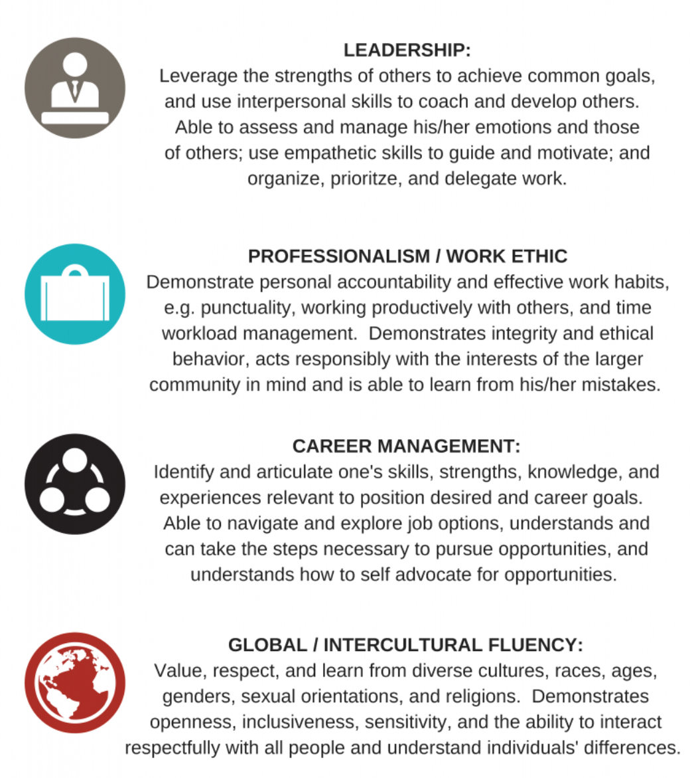
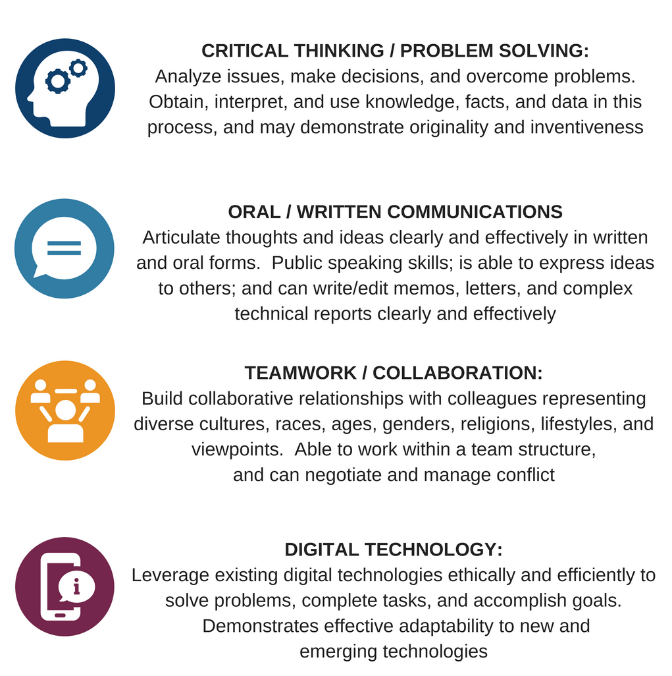
(more) Why teams? (and other class features)
https://ecs.engineering.illinois.edu/career-resources/what-employers-want/

Slide 62
Team Roles
For class worksheets:
Student X: Leader of the day keeps the team linked, coordinated and working together
All members rotate to the leader role

Slide 63
Team Roles
For team project: Rotate roles for each project part
Student 1: Communications officer (but do not forget to cc all teammates in communications with teaching team).
Student 2: Scheduler (creates communication channel, schedules meetings – reserves space or creates virtual meetings).
Student 3: Manager (coordinates team to develop timeline, division of labor, contributes their part while overseeing timely submissions by others.)
Student 4: Integrator of individual contributions into a single report.
Student 5: Quality checker (correctness, format, clarity, organization). In 4 member teams, role can be assumed by communications officer).
Each team member works on their role while contributing their fair share to the analysis and writing.
Members must be involved in ALL parts of the project!

Slide 64
Grade weights
Pre-lecture Checkpoints 5%
Participation grade:
Class Worksheet/Class google form 5%
Weekly Homework 20%
Team Project 25%
4 exams
(worst of first three dropped, if you qualify) 45%
Grade | A+ | A | A- | B+ | B | B- | C+ | C | C- | D+ | D | D- | F
Cutpoint | >97 | >93 | >89 | >85 | >81 | >77 | >73 | >69 | >65 | >61 | >57 | >50 | <50

Slide 65
Class approach to teaching probability and statistics
Foundation class that helps CEEs build background for dealing with uncertainties in real world problems.
We take an applied approach.
Focus is on applications of theorems, very few theorem proofs.
Important to know and understand what the theorems state and under what assumptions they are true.

Slide 66
What is the pace of the class?
Fast!

Slide 67
Teaching philosophy

Slide 68


Slide 69
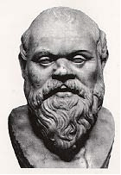
Teaching Philosophy – Student - centered
Socratic approach, also known as the dialectical approach to teaching is based on the practice of disciplined, thoughtful dialogue. The instructor professes ignorance of the topic under discussion in order to elicit engaged dialogue with students. Socrates was convinced that disciplined practice of thoughtful questioning enables the student to examine ideas logically and to be able to determine the validity of those ideas.
This type of questioning can correct misconceptions and lead to reliable knowledge construction. It can also:
Model scientific practices of inquiry
Support active, student-centered learning
Facilitate inquiry-based learning
Help students to construct knowledge
Help students to develop problem-solving skills
Improve long-term retention of knowledge
(Source: http://serc.carleton.edu)
Socrates (ca. 470-399 B. C.): early Greek philosopher and teacher.
I know… this is a busy slide but boy! this guy was cool!

Slide 70
In fewer words?
Teacher’s job is to show the way
It is the student’s responsibility to travel it by asking questions and actively working on providing answers to these questions

Slide 71
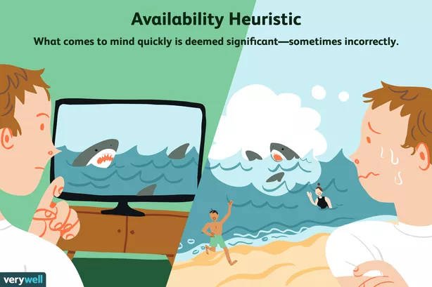
Human brains are not naturally good at probability, so many of the concepts in this class will be counterintuitive.

Slide 72

Instructors often hear: “I hear probability and stats are not relevant to me as a CEE!”
Hm….,
why is this class required then?

Slide 73
More productive frames of mind
How can I use probability and statistics in my engineering applications?
How about stop fretting about the grade and start paying attention to what you learn?
Guaranteed: When you learn well, the high grade follows.
It’s not a chase for survival! It’s an adventure!

Slide 74


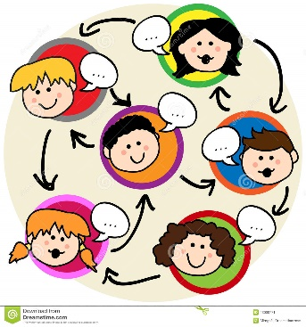

You can succeed in this class easily
Come to class
Stay focused on what we do in class
/Teachers no brain-cell donors – only facilitators/

Slide 75


You can definitely succeed in this class!
Work on all assignments and examples
Submit every assignment on time!
Study from day 1 even if you have seen some material in high school
Ask questions, as you study
Come to office hours to ask questions
You are not alone!

Slide 76
Collaboration or Cheating?
The line between collaboration and cheating is fuzzy (or is it?).
When you are working in groups, searching for a solution to a problem, looking through possible answers for the best one, or sorting out material to include in a presentation, that’s
Collaboration OR Cheating?
Collaboration

Slide 77
Collaboration or Cheating?
When one student in the group solves the problem and everyone else copies the answer, that’s
Collaboration OR Cheating?
Cheating

Slide 78
Collaboration or Cheating?
When one student fails to deliver material she or he’s been assigned and the rest of the group covers, that’s
Collaboration OR Cheating?
Cheating

Slide 79
Collaboration or Cheating?
When you copy your friend’s homework or maybe your roommate’s old homework, that’s
Collaboration OR Cheating?
Cheating

Slide 80
Collaboration or Cheating?
Is splitting the parts of teamwork where only one member works on each part
Collaboration OR Cheating?
Cheating

Slide 81
Shortcuts and cheating are hurting you
EXAMS are not collaborative! If you take shortcuts with preparation (i.e., homeworks, studying) then you create learning gaps that show up in the exams. More important: they will show up in subsequent courses and your job!
Have control!
Be conscious of when collaboration turns into cheating.
Cheating won’t help you with learning or succeeding with exams!

Slide 82
College and sports are alike

Slide 83
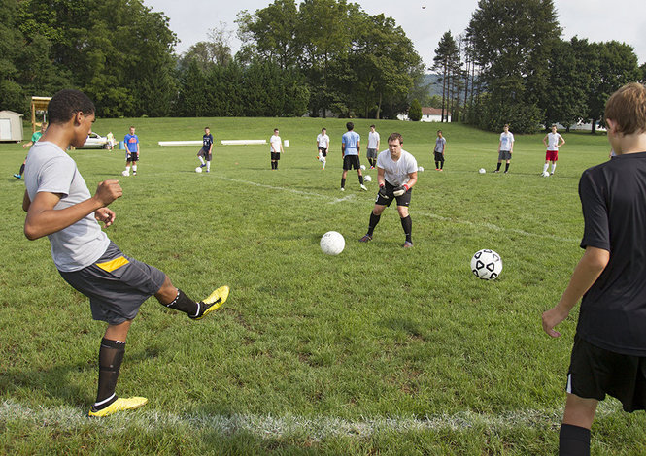
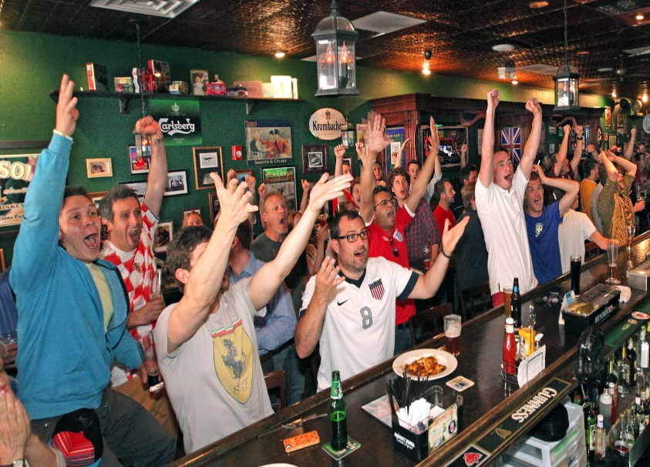
What makes the player?
This?
OR
This?
83

Slide 84
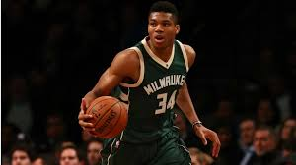

YOU GOT TO ‘PLAY BALL’!
Giannis Antetokounmpo
Because THIS CAN’T HAPPEN!
http://www.mlmcpherson.com/blog-omde-603/lectures-and-constructivism-never-the-twain-shall-meet

Slide 85
What practice resources do you have available?
Examples in book and slides
Worksheet problems
Weekly review handouts
Practice problems on PrairieLearn
Weekly homework problems
Need more?
Internet is packed with materials from reliable resources such as University Statistics departments all over USA

Slide 86
Important reminder

Slide 87



Safety: Run > Hide > Fight
Always be prepared for an emergency.
Run
Hide
Fight
Leave the area
quickly
If you can’t run,
take shelter indoors
Last resort

Slide 88

Question time

